Slide 1
Reverse Engineering with Hardware Debuggers
11 Mar 10
JASON RABER and JASON CHEATHAM
ATSPI Assessment Science Team
RYTA
Air Force Research Laboratory
Public release authorization 88 ABW-10-1497
Notes:
[[ Jason Raber speaks ]]
Hello, my name is Jason Raber and this is my co-worker Jason Cheatham. We work for the Air Force Research Laboratory, specifically the Autonomic Trusted Sensing for Persistent Intelligence branch. Our primary mission is to assess and protect government systems. The team I lead is in charge of assessing the strength and weaknesses of software based protections. We are black hats who emulate the bad guys and break software protections to judge how long a protection can survive in the wild. By survive I mean how long the protections last for 3 objectives (reverse engineering, piracy, and tampering).
Today we will be giving you an overview of one of the reverse engineering tools used by our office. Specifically a hardware emulator.
By the way, before we proceed I must state that we can not answer questions in a public forum or go off our given already approved script. Due to public approval process we must stick to the script that has been approved for public release.
Our intent for this talk is to give an overview of the hardware emulator, the American Arium specifically with the slant of targeting the reverse engineer and how to use an ICE effectively. We have found that there really are not a lot of good tutorials or presentation on this powerful capability.

Slide 2
Outline
Architecture
Breakpoints
Macros
Hypervisors
Notes:
[[ Jason Raber speaks ]]
Here is an outline of the hardware emulator topics we will be discussing:
Architecture
Breakpoints
How to develop macros for source point.
Using a hardware emulator for debugging a hypervisor
First, we’re going to give you an overview of the architecture of a standard in-circuit emulator.

Slide 3
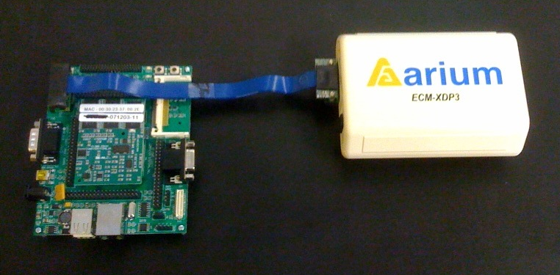
The Hard Way
Hardware debugger / in-target probe (ITP) / in-circuit emulator (ICE)
Socket
CPU
Notes:
[[ Jason Cheatham speaks ]]
This is a photo of the Arium ECM-XDP3, one of the more popular x86 ICEs. Emulator is a bit of a misnomer since the device isn’t really emulating an x86 processor (at least not most of the time). What it’s really doing is making use of the CPU’s built-in debugging facilities via the CPU JTAG port. This allows you to do some interesting things like read memory, change registers, and completely halt the processor.
<click>
To use an ICE, you need two systems: a target and a controller, similar to a WinDbg remote debugging setup. One end of the ICE gets connected to the target system board and the other end is plugged into the controlling system. The controller runs debugging software; in our case, it’s an application called SourcePoint (more on that in a bit).
<click>
If you’re lucky, you have a motherboard that has a JTAG header built into the board. In that case, you can connect the ICE directly to the motherboard and you’re ready to go. Unfortunately, most motherboards don’t include debug ports (added expense and all that), so you’ll have to take a more expensive route.
<click>
When the motherboard doesn’t provide a debug header, you need an interposer. This is basically a shim that sits between the CPU and the socket. Most pins are simply passed through, but the JTAG pins are routed to a debug header. Unfortunately, interposers aren’t cheap; they add another 20% to the price of an already rather pricey ICE setup (an additional $2k). You also have to be careful not to damage pins on the CPU, and BGA interposers have a pretty short lifespan (in terms of how many times you can insert and remove a CPU).

Slide 4
Friends with Benefits
Hardware debuggers can see almost everything
They live outside the OS, so even kernel mode rootkits can’t hide
Rewriting firmware
They’re OS independent
Just needs a compatible x86 processor
Notes:
[[ Jason Raber speaks ]]
There are certain limitations to using a kernel debugger like WinDBG on Windows or KDBG on Linux. For example debugging hardware, firmware, hypervisors, and rewriting firmware. It is not our intent to bad talk WinDbg but make people aware of other tools available to use for reverse engineering PC’s and embedded systems.
Let me first point out that you obviously need physical access to that machine for a $13,000 hardware emulator is going to be any use for reverse engineering. I realize that the $13K is a bit steep for price of entry to use debugger, however, if you do have the money it is a very good tool for getting around virtually all software based protections utilized by malware today.
So why is it so cool? Well, you can debug any OS for x86, whereas for Linux you are constrained to using KGDB or Windbg for Windows

Slide 5
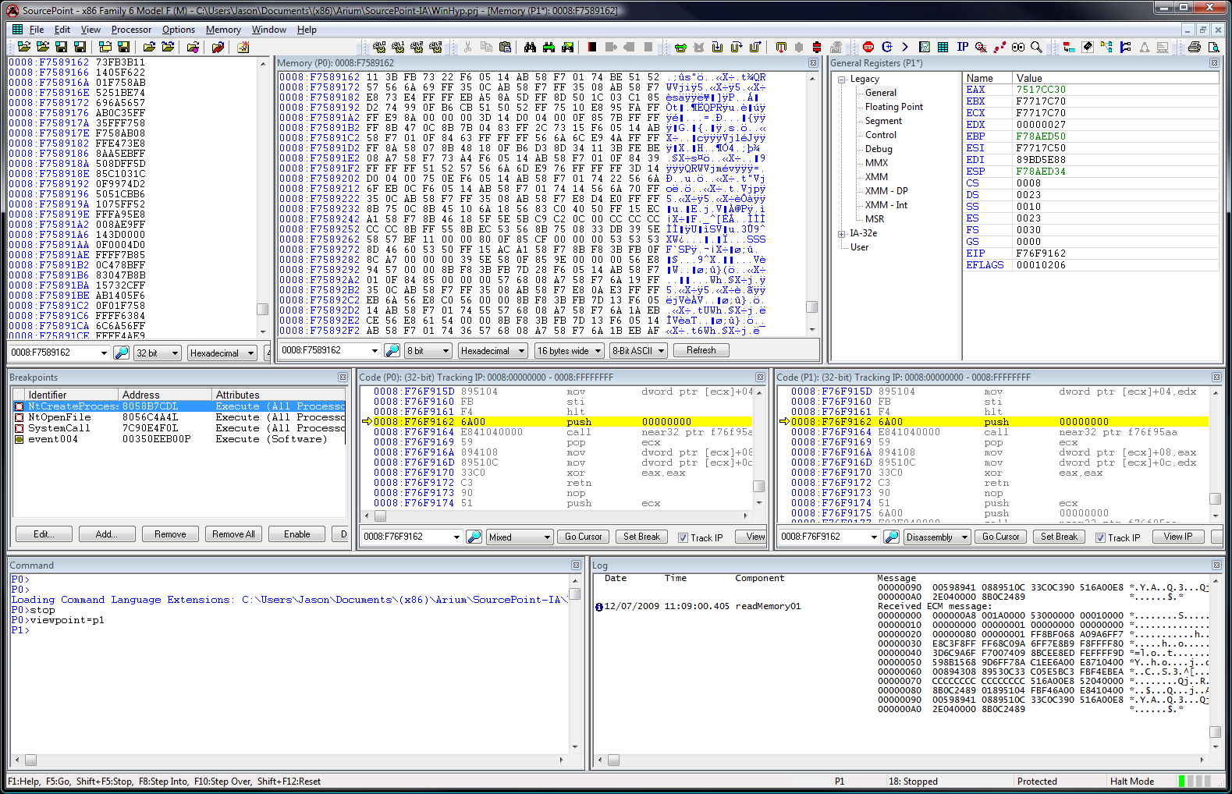
The Softer Side
Notes:
[[ Jason Raber speaks ]]
Here is a screen shot of Source Point, which is American Arium’s debugger interface. It runs on Windows, and is the gateway to hardware-assisted debug support for the Intel 32 and 64-bit processors and AMD64 processors. This application will help you debug the hardware, BIOS, kernel, drivers, and embedded software.
<click> As you can see there are 2 code view windows that allows you to see the EIP for the multiple cores.
<click>You can also modify memory, <click> change registers, <click> or load or create your own macros for more power. It has everything that can be found in a typical debugger.
<click>Truth is that using a hardware emulator looks very much like using any old debugger with minor differences.

Slide 6
Outline
Architecture
Breakpoints
Macros
Hypervisors
Notes:
[[ Jason Raber speaks ]]
Next lets talk about breakpoints and how the hardware debugger uses them

Slide 7
Ways to Break Things
Hardware Breakpoints
DR registers
Software Breakpoints
ICEBP (0xF1) instruction + DR7 bit 12
Infinite loops
Steal a couple bytes and replace with 0xEBFE
Notes:
[[ Jason Raber speaks ]]
The emulator supports the two most common types of breakpoints, hardware and software. It also makes a third kind of breakpoint very useful: infinite loops.
Hardware Breakpoints
Hardware breakpoints are pretty standard—the emulator sets a linear memory address in a DR register, and when it hits the emulator gets notified. The way the emulator is notified is by setting the 12th bit in DR7. This is an undocumented flag in the register that works with emulators. When bit 12 is set, breakpoint conditions cause the CPU to halt and the emulator to be notified. Without bit 12, breakpoints are handled by the normal processor exception handler (or you get a blue screen if they’re not).
Software Breakpoints
How does the Hardware emulator trap on software breakpoints? Typical breakpoints used by COTS debuggers use INT 3 instruction via the 0xCC instruction. For the hardware emulator they use an INT 1 via the 0xF1 instruction (ICEBP). Just like a CC, when the processor stops, the original instruction is written back to the address the software breakpoint was added. The 12th bit must be set in DR7 for the emulator to catch SW breakpoints.
Infinite Loops
An infinite loop breakpoint isn’t really a breakpoint, it’s just a way to make the processor sit still until you can halt it with the emulator. We use an 0xEBFE instruction, which is just a jump to the current address. Similar to a SW breakpoint, we steal the two bytes and replace them when we’re ready to step past the breakpoint.
Detection
All three of these could be detected. SW and infinite loop breakpoints leave traces in the program in memory that could be caught by checksums, and hardware breakpoints make visible changes to the DR registers.
We like the software breakpoints (especially the infinite loops) because you don’t have to deal with the virtual memory system. A SW breakpoint will only break when it needs to.

Slide 8
Infinite Breakpoints
EB FE is a jump to the same address (jmp $)
Inject the infinite loop (0xEBFE) into the application or driver
Halt the CPU when the system freezes, and there you are
They’re very easy to use with an ICE
No worries about freezing the system
Don’t have to deal with virtual memory
Checksums can detect these, so place them carefully
Notes:
[[ Jason Raber speaks ]]
We mentioned we like EBFEs most of all. So, why do we like them so much?
EBFE is the opcode for a jump to the same address. When you add an EB FE instruction to an application, the application will go into an infinite loop when the EBFE is hit. You just have to halt the emulator and replace the stolen bytes, then you can begin stepping through the code.
When you’re using an emulator, you can put EBFEs anywhere. You can strategically apply infinite loop breakpoints into kernel, say, within the OS loader, Linux execve() or the NtCreateProcess() function. There are many different spots that you can effectively target the malware you want to start dynamic analysis on.
This is a good technique for breaking into the running malware before it gets loaded or at an interesting spot in memory you want to start debugging.
Also, EBFE can make it easier on the reverser:
No manually converting page directories, Page table entries to physical addresses: When drivers are loaded you don’t have to see were the OS loaded the driver and calculate the address of where you want to add a BP.
Linear address created by adding the logical address to the base of the segment (CS)
When paging, the page tables are used to translate the linear address to the physical address
Debug registers used break on linear and not physical addresses: It is nice not have to worry about hardware breakpoints getting triggered on the OS swapping in processes for another and trapping on a linear address.
Can you get caught by checksums? Absolutely, however, if you strategically place the EBFE in the OS loader or in the driver or app before the checksum you will not get caught. Really no different from a software breakpoint!

Slide 9
Outline
Architecture
Breakpoints
Macros
Hypervisors
Notes:
[[ Jason Raber speaks ]]
Next, Jason’s going to talk about some of the flexibility the hardware emulator gives us with macros

Slide 10
More Power…
Macros can make an emulator very powerful
Implement complex or repetitive tasks
Detailed control of ICE
SourcePoint uses a C like scripting language
Variables, functions, control flow
Types have well-defined widths
ord1, int4, real8, …
Control statements for ICE
define proc pcrange(startaddr, endaddr)
define ord4 startaddr
define ord4 endaddr
{
while (1) {
if (EIP >= startaddr &&
EIP <= endaddr) {
break
} else {
step 4
}
}
}
Notes:
[[ Jason Cheatham speaks ]]
Much like other customizable debuggers, SourcePoint has a macro engine that allows you to automate a variety of tasks. You can use macros to do things like implement stealthy breakpoints or provide OS-specific semantic information (like a list of processes running on the system). The SourcePoint macro language includes many emulator control functions that give you a lot of control.
The language used by SourcePoint is an interpreted C-like language. It has all the standard features like variables, functions, and control flow statements, along with some hardware-specific elements. For instance, all the types but strings have well-defined widths (in bytes).
Example
On the right is an example macro that illustrates some of the standard language features. We’re defining a procedure that takes a couple arguments. Arguments can be optionally typed by defining them between the procedure declaration and the actual start of the procedure. We’ve got an infinite while loop, a comparison using the current value of the EIP register, and some direct emulator control with “step” and “stop”.
The example on the right acts like a memory range breakpoint, but without actually setting a software or hardware breakpoint. It single steps until an instruction in the target range is about to be executed, then halts the target CPU. For speed, we have the loop stepping 4 instructions at a time so that it’s not doing the EIP check as often. It’s still not fast (not nearly as fast a software tracing), but it’s better than doing it by hand.

Slide 11
Range Breakpoint
Notes:
[[ Jason Cheatham speaks ]]
This is a short video of me running the pcrange breakpoint. It’s just to give you a feel for how macros work in SourcePoint.
<click>
First I stop the emulator; we end up at one of our EB FE breakpoints. Here I’m writing two bytes to the code to restore the bytes I stole for the EB FE instruction.
With those two bytes restored, I can run the pcrange macro. There’s the instruction pointer automatically stepping through the code until it gets in the range I specified. Once the instruction pointer lands within the range, the macro will stop execution and allow you to examine the state of the registers and memory without using CC’s or DR registers

Slide 12
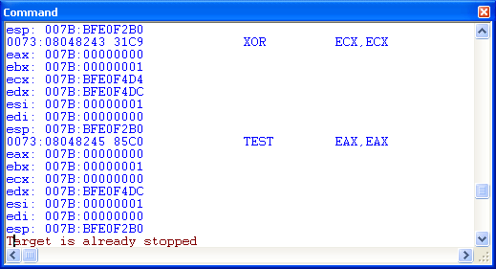
Run Trace
flist (“tracelog.txt”, 1)
define ord4 lasteip = EIP
softremove
while (1) {
if (EIP >= 0xC0000000 && lasteip < 0xC0000000) {
softbreak = location=lasteip+2
softbreak = location=lasteip+3
softbreak = location=lasteip+4
softbreak = location=lasteip+5
softbreak = location=lasteip+6
lasteip = EIP
go
}
if (EIP != endaddr) {
asm eip
printf("eax: “); eval eax virtual
printf("ebx: “); eval ebx virtual
printf("ecx: "); eval ecx virtual
printf("edx: "); eval edx virtual
printf("esi: "); eval esi virtual
printf("edi: "); eval edi virtual
printf("esp: "); eval esp virtual
lasteip = EIP
step
} else {
nolog
stop
}
}
Notes:
[[ Jason Cheatham speaks ]]
Here is a macro that will execute a run trace similar to Olly debug or IDA Pro’s run trace feature. It creates a file to store the trace in, then starts stepping until the target address is reached.
The macro avoids stepping through kernel code. When it sees that it’s stepped from user address space into kernel address space, it sets breakpoints at the first few addresses just after the last user EIP. Then it tells the CPU to continue operation. When the target address is reached, the script stops executing.
This version of the script has a logical bug that causes the “Target is already stopped” message. Specifically, the script calls “stop” to when it exits the loop, but there’s really no need to do that since it had to have been stopped for any comparisons with EIP to happen.

Slide 13
From the Outside In
Emulator access is pretty raw, so we wrote some simple forensic macros
list_procs()
get_ssdt()
get_syscall_addr(name)
hook_syscall(name)
list_mods()
Notes:
[[ Jason Cheatham speaks ]]
A hardware debugger on Windows is pretty bare bones, so we’ve developed a few macros to make basic system examination a bit easier. These have been developed for Windows XP SP3, and will probably work for other versions, but almost certainly won’t do much for Vista or Windows 7.
When we started debugging with the ICE, one of our first questions was how we could attach to, or at least look at, a process. One of the standard forensic techniques for looking at processes in memory is to find the head of the active process list and then walk the list. That’s basically what the list_procs macro does, but of course it’s working on a live (paused) system.
Looking at processes is good, but we also wanted to mess with things, so we wrote the hook_syscall macro. Along with a few supporting macros like get_ssdt and get_syscall_addr, this macro lets us hook a Windows system call.
Emulators are also good at debugging drivers (that’s one of they primary ways they’re marketed). To get a foothold in driverland, we wrote a list_mods macro that works a lot like the list_procs macro, but it walks the loaded module list rather than the active process list.
We’ve written a number of other simple macros, but these give some idea of how you can use some ideas from memory forensics to get a toehold in the OS.
<click on video>
This short video shows how macros can be loaded and used from the SourcePoint command line. We first include the macro source file, which loads functions into memory. We can then call functions, like list_procs, which gives you a function list similar to one from WinDbg; or get_syscall_addr function, which takes a string name and returns the address in memory of the give system call.

Slide 14
get_syscall_addr
define proc pointer get_syscall_addr(syscall_name)
define nstring syscall_name
{
if (syscall_name == "NtCreateProcessEx") {
return ssdt_index_to_addr(0x30, 0)
} else if (syscall_name == "NtCreateSection") {
return ssdt_index_to_addr(0x32, 0)
} else {
printf("Unknown system call\n");
return 0
}
}
define proc pointer find_gdi_proc() {
define pointer PsActiveProcessHead = get_head_proc()
define pointer first_proc = flink_to_proc_addr(PsActiveProcessHead)
define pointer current_flink = next_proc_flink(first_proc)
define pointer current_proc = flink_to_proc_addr(current_flink)
while (current_flink != PsActiveProcessHead) {
define ord1 type = proc_type(current_proc)
if (type != 0x03) { printf("Non-process type: %x\n", type); break; }
define ord4 w32proc = proc_win32process(current_proc)
if (w32proc != 0x0) return current_proc
current_flink = next_proc_flink(current_proc)
current_proc = flink_to_proc_addr(current_flink)
}
}
define proc pointer ssdt_index_to_addr(index, table)
define ord4 index
{
define pointer ssdt = get_ssdt()
define pointer service_table_base = ord4 ssdt
return ssdt_service(service_table_base, index)
}
define proc pointer get_ssdt()
{
define pointer gdi_addr = find_gdi_proc()
define pointer tlh_flink = proc_thread_list_head(gdi_addr)
define pointer thread_list_head = flink_to_thread_addr(tlh_flink)
define pointer ssdt = thread_ssdt(thread_list_head)
return ssdt
}
Notes:
[[Cheatham]]
I’d just like to dig a little deeper into the get_syscall_addr macro, just to really give you an idea of what we’re looking at with the Arium.
At the top level, the get_syscall_addr macro looks simple enough. It checks the given name against a list, and if it knows the index, the macro returns the function address. How is the ssdt_index_to_addr procedure implemented?
This procedure is actually simple enough—it just gets a pointer to the base of the SSDT and increments it. Where is the SSDT address coming from, though?
Here’s where things get a bit more interesting. The Arium can’t simply look at exported symbols, because it doesn’t exist inside the operating system. We therefore have to use some forensic tricks. In this case, we find a Windows GDI process and pull a pointer to the SSDT out of one of its thread’s ETHREAD structure.
Finding a GDI process is really the most involved part of the process. We find the active process head, using a Windows XP-specific trick involving the KPCR structure, which is always at a known location. From there we walk through the active process list, checking each process to see if it’s Win32Process field has a non-zero value. As soon as we find one, we return it.
You can get some pretty neat high-level functionality out of the Arium by building up a library of relatively simple macros.

Slide 15
Outline
Architecture
Breakpoints
Macros
Hypervisors
Notes:
[[ Jason Cheatham speaks ]]
Next I’ll talk a bit about using the hardware debugger to debug hypervisors

Slide 16
Blue…Something
ICE runs below hypervisors
You can go far with a few simple macros
vmx_is_enabled
vmx_goto_resume
vmx_guest_eip
vmx_exit_reason
Notes:
[[ Jason Cheatham speaks ]]
You can do a lot of the stuff we’ve been talking about with any kernel debugger, but software kernel debuggers run into problems with stealthy hypervisors because the hypervisor runs at a lower privilege level than an OS kernel. Hardware debuggers take things to a whole other level.
Once you locate the hypervisor (no, an emulator can’t do everything for you), you can place a breakpoint in the main hypervisor trap function to get access when the guest exits. At that point you can do all kinds of fun things, a few of which we’ve written simple macros for.
* vmx_is_enabled will indicate whether VMX mode is enabled on the target CPU
* vmx_goto_resume will single step through code until a VMRESUME instruction is encountered
* vmx_guest_eip returns the EIP of the active guest
* vmx_exit_reason displays why the VM exit occurred
These are pretty basic tools, but you can learn a lot about a target system with just these functions.

Slide 17
Down We Go…
Notes:
[[ Cheatham ]]
These videos show how we use the emulator to examine hypervisors. If it seems like I’m cheating a bit…well, I am. This is the demo hypervisor that Shawn Embleton put out on rootkit.com a couple of years ago, and it’s not exactly trying to be super stealthy.
The first step is to actually find the hypervisor. Currently we just brute force it by dumping memory. We’re helped out because we have some idea of where the hypervisor lives, but it can still take a while (unless we really, really cheat and just look where the hypervisor says it was loaded). Memory dumping from an emulator can be slow or slower (this is the slow way).
Once we’ve dumped memory, we need to see if we actually found anything. We do that by opening up the binary in IDA and searching for potential VM instructions. In this case, I’m looking for 0F 01 C3, which is a VMRESUME instruction. This is a good one to look for because a hypervisor will typically have to call this instruction to switch back to the VM. The VMRESUME is the last thing called in the hypervisor code, so I’m guessing these CC’s are filling the space between functions. So by searching backwards, I can find the beginning of the code. A little ways down I see a VMREAD, which is a good sign that I’m still in VM code. I’ll note the address of the function a save that for later.
Now that I’ve got a potential address for the hypervisor code, I switch back to SourcePoint and check it out. Sure enough, there’s the hypervisor code, including the VMREAD. I’ll set a software breakpoint at the beginning of the hypervisor code and start up the CPU again. Almost immediately I’m at my breakpoint. I can single step through the hypervisor at this point, examining and changing code and memory just like any other program.
As I mentioned before, we’ve written a few macros to make working with VMs a little easier. One is the vm_gest_eip procedure, which will actually insert a VM read instruction into target memory and execute it (which only works when the CPU is already in VMX mode). Another is the vm_goto_resume, which will allow you to trace execution to the end of the VM handler.

Slide 18
Nobody’s Perfect
You can’t single step or trace across the ring -1/0 boundary
Finding the hypervisor is tricky
Newer VM instructions can cause problems
Notes:
[[ Cheatham ]]
Now for the bad news (you knew there was bad news).
One big limitation to using an emulator to debug hypervisors is that you can’t single step across the ring -1/0 boundary—entering or exiting VMX mode clears the trap flag. This means that you can’t step into the hypervisor when a guest makes a privileged call, and you can’t step directly back into user land from the hypervisor.
Without being able to trace or step into the hypervisor, finding it is the really tricky part. As you saw in the video, an ICE is not the fastest way to scan gigabytes of memory (it would take hours to do a full memory dump), but it’ll do if you have some idea of where a hypervisor might be living.
Another issue are secure VM instructions. Instructions such as AMD’s SKINIT, which is intended to allow a VM to be securely loaded, disable hardware debugging support in the processor. Even an emulator can’t see what’s going on then.

Slide 19
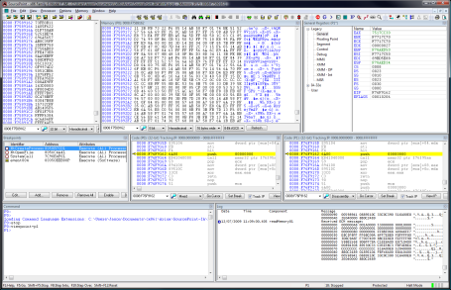
Summary
The Debuginator
Notes:
[[ Raber ]]
In summary, when you combine a software debugger with a JTAG emulator, something amazing happens… You get…The Debuginator! See the majesty…
The combination of a typical software debugging environment with a hardware component gives you a lot of power. It puts you way below ring 0, which can let you see and do almost anything. It’s not always easy to work with, but with simple macros you can accomplish a lot.
Just as a reminder, we’re on a script and can’t answer any questions right now. Thanks for your time.

