Slide 1
X86 Binary Rewriting Many Binaries. Such Secure. Wow.
Richard Wartell (@wartortell)
06/29/14

Slide 2
Outline
Autobiography
Attack Surface & History
Rewriting x86 Binaries
Defeating ROP on x86
Enforcing Security Policies on x86
DIY
Questions

Slide 3
Autobiography
Richard Wartell, Phd. in CS from UT Dallas
This talk covers my thesis and ongoing research at UTD
Working for Mandiant/FireEye ever since
Malware analysis, incident response, automated unpacking of binaries, computering, etc.
Part of the newly formed FLARE team
Focusing on reverse engineering and research

Slide 4
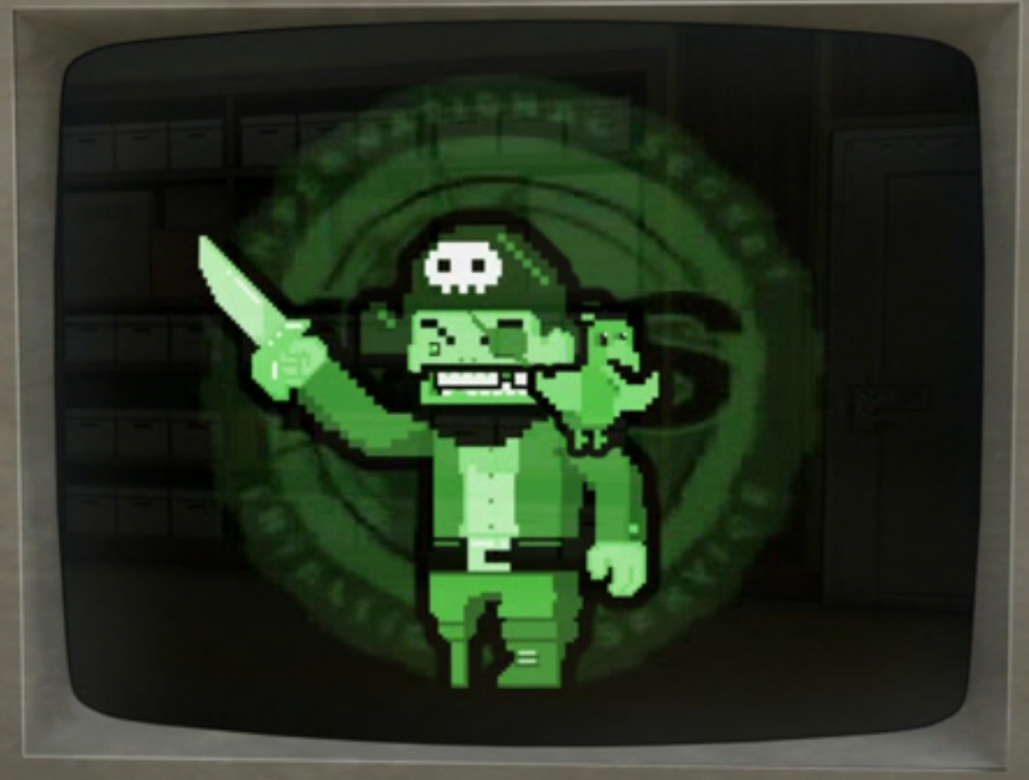
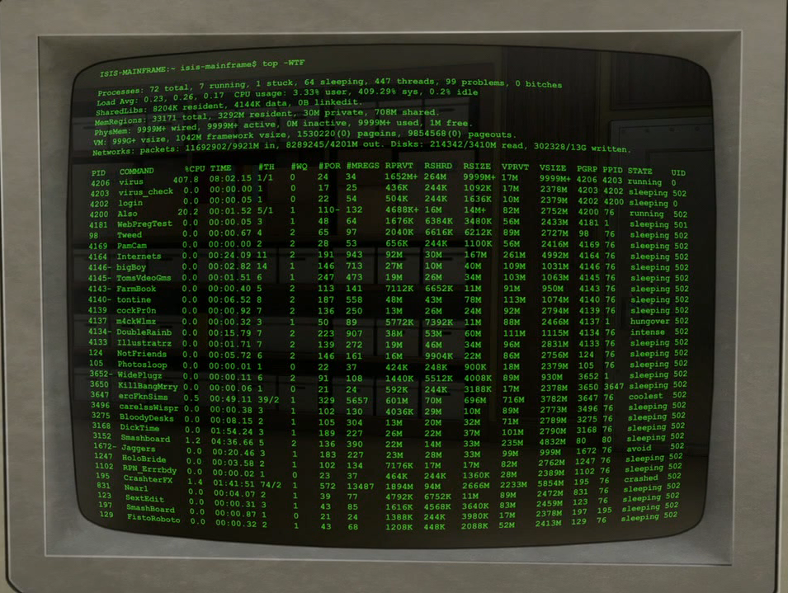
The Ol’ Faithful
Buffer Overflow

Slide 5
Stacks and Stacks
Stack
fread() return
Some stack address
Legit
909090909090909090909090909090909090909090909090909090909090909090909090909090909090909090909090909090909090909090909090909090909090909090909090909090909090909090909090909090909090909090909090
Make stack
non-executable
fread(<evil buffer>)

Slide 6
Return to Libc
Stack
fread() return
evil_API()
evil_arg1
evil_arg2
evil_arg3
etc…
Legit crap
ASLR
fread(<evil buffer>)

Slide 7
Return-Oriented Programming
The new gold standard
Attacker uses your own code against you
Finds a series of gadgets and forces them to be executed in sequence
A gadget is a series of instructions in executable process memory that ends with a return

Slide 8
Return-Oriented Programming
Binary
Attack Sequence
Runtime Stack
Stack
Address | Value
0028FF8C | <return_val>
0028FF90 | <st_1>
0028FF94 | <st_2>
0028FF98 | <st_3>
0028FF9C | <st_4>
0028FFA0 | <st_5>
0028FFA4 | <st_6>
0028FFA8 | <st_7>
0028FFAC | <st_8>
0028FFB0 | <st_9>
0028FFB4 | <st_10>
0028FFB8 | <st_11>
Stack
Address | Value
0028FF8C
0028FF90
0028FF94
0028FF98
0028FF9C
0028FFA0
0028FFA4 | <st_6>
0028FFA8 | <st_7>
0028FFAC | <st_8>
0028FFB0 | <st_9>
0028FFB4 | <st_10>
0028FFB8 | <st_11>
.text
FF D6 3D E5 03 00 00 74
5D C2 0C 00 55 8B EC 8B
56 8D 48 20 51 FF B0 74
00 85 C0 75 08 FF 15 B8
D8 1B C0 25 BA D8 FF FF
08 00 55 8B EC 56 8B 75
3D 00 85 C0 75 08 FF 15
…
5
3
*<Gadget 1>
1
*<Gadget 2>
*<Gadget 3>
*<Gadget 4>
2
*<Gadget 5>
6
*<Gadget 6>
7
4
A gadget is a series of instructions that ends with a return

Slide 9
Why do you care?
This is the current generation of attacks
People are paying good money for discovery and mitigation
Microsoft’s 2012 BlueHat Competition
$260,000 total for top three solutions
Successful attack against 2nd place solution was published one month later
Google paid Pinkie Pie $60k for a ROP attack on Chrome
They patched it
One month later they paid Pinkie Pie another 60k for a new ROP attack they introduced with the patch

Slide 10
ROP Defense Strategy
ROP is one example of a broad class of attacks that require attackers to know or predict the location of binary features
Defense Goal
Frustrate such attacks by randomizing feature space or removing features

Slide 11
Anti-RoP Compilers
let rec merge = function
| list, []
| [], list -> list
| h1::t1, h2::t2 ->
if h1 <= h2 then
h1 :: merge (t1, h2::t2)
else
h2 :: merge (h1::t1, t2);;
Control the machine code instructions used in compilation (Gfree [2] and Returnless [3])
Use no return instructions
Avoid gadget opcodes
Hardens against ROP
Requires code producer cooperation
Legacy binaries unsupported
Gadget-removing Compiler
Gadget-free Binary

Slide 12
ASLR
2³²
ASLR randomizes the image base of each library
Gadgets hard to predict
With the right gadgets you can calculate your offset
Brute force attacks still possible [4]
Sys. Address Space
Virtual Address Space
User Address Space
2⁰

Slide 13
IPR / ILR
Instruction Location Randomization (ILR) [5]
Randomize each instruction address using a virtual machine
Increases search space
Cannot randomize all instructions
Overhead due to VM (13%)
In-place Randomization (IPR) [6]
Modify assembly to break known gadgets
Breaks 80% of gadgets on average
Cannot remove all gadgets
Preserves gadget semantics
Deployment issues
User Address Space
2³¹
lib1
lib2
lib3
main
2⁰

Slide 14
Our Goal
Self-randomizing COTS binary w/o source code
Low runtime overhead
Complete gadget removal
Flexible deployment (copies randomize themselves)
No code producer cooperation

Slide 15
Our Goal
Rewritten Binary
Original Binary
Rewritten Binary (Runtime)
.text
6
7
1
8
1
First Execution
1
9
2
2
7
3
6
4
4
5
Second Execution
3
10
5
9
4
6
2
5
7
3
8
10
9
10
8
#
Basic Code Block
We define a basic code block as any sequence of instructions that ends with an unconditional branch (jmp or retn)

Slide 16
Binary Randomization is Hard
Relocation information, debug tables and symbol stores not always available
Reverse engineering concerns
Perfect static disassembly without metadata is provably undecidable
Best disassemblers make mistakes (IDA Pro)
Program | Instruction Count | IDA Pro Errors
mfc42.dll | 355906 | 1216
mplayerc.exe | 830407 | 474
vmware.exe | 364421 | 183

Slide 17
Unaligned Instructions
Disassemble this hex sequence
Undecidable problem
FF E0 5B 5D C3 0F 88 52 0F 84 EC 8B
Valid Disassembly
FF E0 | jmp eax
5B | pop ebx
5D | pop ebp
C3 | retn
0F 88 52 0F 84 EC | jcc
8B … | mov
Valid Disassembly
FF E0 | jmp eax
5B | pop ebx
5D | pop ebp
C3 | retn
Valid Disassembly
FF E0 | jmp eax
5B | pop ebx
5D | pop ebp
C3 | retn
0F | db (1)
0F 88 | db (2)
88 52 0F 84 EC | mov
8B … | mov
52 | push edx
0F 84 EC 8B … | jcc

Slide 18
STIR all the things
Self-Transforming Instruction Relocation
Statically rewrite legacy binaries
Rewritten binaries will randomize at a basic block level every execution
Greatly increases search space against brute force attacks
Introduces no deployment issues
Tested on 100+ Windows and Linux binaries
99.99% gadget reduction on average
1.6% overhead on average
37% process size increase on average

Slide 19
STIR Architecture
Binary Rewriter
Memory Image
Conservative Disassembler
Load-time Randomizer
(Helper Library)
Original
Application
Binary
Self-stirring
Binary
Lookup Table
Generator
Randomized Instruction Addresses
Static Rewriting
Phase
Load-time Stirring Phase

Slide 20
Disassembly Error Tolerance
FF E0 5B 5D C3 0F 88 B0 50 FF FF 8B
Disassembled Invalid
 | Hex |  | Path 1 |  | Path 2 |  | Path 3 |  | Path 4
 | FF |  | jmp eax
 | E0 |  |  |  | loopne
 | 5B |  | pop
 | 5D |  | L1: pop
 | C3 |  | retn
 | 0F |  | jcc
 | 88 |  |  |  |  |  | mov
 | B0 |  |  |  |  |  |  |  | mov
 | 50
 | FF |  |  |  |  |  |  |  | N/A
 | FF
 | 8B |  | L2: mov
Included Disassembly
jmp eax
pop
L1: pop
retn
jcc
L2: mov
loopne
jmp L1
mov
jmp L2

Slide 21
Dynamic Jump Table
High Level View
.text
.told
1
2
3
4
5
*1’
*2’
*3’
*4’
*5’
#
Code Function
.tnew
1’
2’
3’
4’
5’
Marker Byte (0xF4)

Slide 22
Dynamic Jump Table
Low level view
Original Binary
Rewritten Binary
Function 1
Function 1
B0 23 51 00
0x401000:
55 8B EC 83 EC 10 56 57 8B 3B 33 C0 83 C7 04 …
0x401000:
F4 B0 23 51 00
0x401000:
55 8B EC 83 EC
0x401000:
F4 B0 23 51 00 10 56 57 8B 3B 33 C0 83 C7 04 …
Rewritten Function 1
0x5123B0:
55 8B EC 83 EC 10 56 57 8B 3B 33 C0 83 C7 04 …
0x5123B0:

Slide 23
Computed Jump Preservation
Original Instruction:
eax = 0x411A40
.text:0040CC9B
FF DO
call eax
call eax
Original Possible Target:
.text:00411A40
5B
pop ebp
pop ebp
eax = 0x534AB9
Rewritten Instructions:
eax = 0x411A40
.tnew:0052A1CB
.tnew:0052A1CE
.tnew:0052A1D2
80 38 F4
0F 44 40 01
FF D0
F4h
cmp byte ptr [eax], F4h
cmovz eax, [eax+1]
call eax
cmp byte ptr [eax], F4h
cmovz eax, [eax+1]
call eax
Rewritten Jump Table:
.told:00411A40
F4 B9 4A 53 00
F4 dw 0x534AB9
F4
0x534AB9
Rewritten Target:
.tnew:00534AB9
5B
pop ebp
pop ebp

Slide 24
Static Rewriting
Original Binary
Rewritten Binary
Header
Rewritten Header
IAT
IAT
.data
.data
.text
.told (NX bit set)
1
2
3
4
5
*1’
*2’
*3’
*4’
*5’
.tnew
#
Basic Code Block
Marker Byte
1’
2’
3’
4’
5’
Modified Section

Slide 25
Load-time Stirring
When binary is loaded:
Initializer randomizes .tnew layout
Lookup table pointers are updated
Execution is passed to the new start address
User Address Space
2³¹
lib1
lib2
lib3
main
2⁰

Slide 26
Do a thing…
INSERT
DEMO HERE

Slide 27
MATH!
Entropy of a brute force attack:
ASLR
2^{n-1} probes where n is the number of bits of randomness
STIR
$\frac{\left(2^{n}\right)!}{\text{2(}2^{n}\text{ −}\text{g}\text{)}!}$ probes where g is the number of gadgets in the payload
Must guess each where each gadget is with each probe.

Slide 28
Gadget Reduction

Slide 29
Why not 100%?
Tiny gadgets
pop ebx
retn
pop ecx
retn

Slide 30
Windows Runtime Overhead

Slide 31
Linux Runtime Overhead

Slide 32
STIR Conclusions
First static rewriter to protect against ROP attacks
Greatly increases search space
Introduces no deployment issues
Tested on 100+ Windows and Linux binaries
99.99% gadget reduction on average
1.6% overhead on average
37% process size increase on average

Slide 33
What else?
So we have a ROP mitigation rewriter, what about security policies based on API calls?
E.g. No network sends after read from the file system
REINS
Wrap system library APIs with our own code
Specify regular expression based security policies
Guarantee security policy cannot be circumvented
Accomplished via Software Fault Isolation (SFI) and an Inline-Reference Monitor (IRM)

Slide 34
Software Fault Isolation (SFI)
Trusted & untrusted modules in common address space
Example #1: web browser plug-ins
Example #2: trusted system libraries inside untrusted application
Goal: protect trusted modules from untrusted ones
confine untrusted module behaviors
Example: Untrusted modules must obey trusted module interfaces
Blocks ROP attacks [Shacham07]
kernel32.dll
user.dll
Trusted
Untrusted
eMule.exe

Slide 35
Inlined Reference Monitors (IRMs)
SFI foundation supports higher-level policies [CFI05]
Example: IRMs [Schneider00]
Enforces powerful policies:
program-specific (no other programs affected)
light-weight enforcement (minimize context switches)
Statefulness
Example: Adobe Reader may access the network (to check for updates) and may read my confidential files, but may not access the network after reading my confidential files.
kernel32.dll
user.dll
Trusted
IRM
Untrusted
eMule.exe

Slide 36
A Brief History of SFI
1995 2000 2005 2010
XFI⁴
NaCl⁵
Wahbe¹
PittSFIeld³
CFI / SMAC²
1: [Wahbe93] 2: [CFI05] 3: [PittSFIeld06] 4: [XFI06] 5: [NaCl09]

Slide 37
A Brief History of SFI
1995 2000 2005 2010
XFI⁴
Needs PDB
NaCl⁵
Special GCC
Wahbe¹
RISC only
PittSFIeld³
GCC only
CFI / SMAC²
Needs PDB
All prior works require explicit code-producer cooperation
1: [Wahbe93] 2: [CFI05] 3: [PittSFIeld06] 4: [XFI06] 5: [NaCl09]

Slide 38
The Solution?
Three main modifications
Separation of trusted and untrusted modules via memory
High memory is trusted
Low memory is untrusted
Use masking to enforce this
Use PittSFIeld approach to SFI
Turns every chunk (16 bytes) into an atomic unit of execution
Use the same framework as STIR for preserving behavior
Old code section becomes a jump table with marker bytes
New rewritten code section is added

Slide 39
Separating Code from Data
Original Memory Layout
Rewritten Memory Layout
Rewritten Binary
Original Binary
Low Memory
High Memory
kernel32.dll
user32.dll
user32.dll
kernel32.dll
Memory separation is chosen at location 2^{d}
(32-d) is the number of high order bits we must mask

Slide 40
PittSFIeld
Address | Instruction
0x40111A | mov eax, [ebp+8]
0x40111D | push 0x80008000
0x401122 | call eax
0x401124 | push eax
0x401125 | call 0x4012BC
… | …
0x4012BC | push ebp
Address | Instruction
0x40111A | mov eax, [ebp+8]
0x40111D | push 0x80008000
0x401122 | call eax
0x401124 | push eax
0x401125 | call 0x4012C0
… | …
0x4012BC | nop (x4)
0x4012C0 | push ebp
Address | Instruction
0x40111A | mov eax, [ebp+8]
0x40111D | push 0x80008000
0x401122 | nop (*C)
0x40112E | call eax
0x401130 | push eax
0x401131 | nop (*A)
0x40113B | call 0x4012C0
… | …
0x4012BC | nop (*4)
0x4012C0 | push ebp
0x4012C1 | mov ebp, esp
Address | Instruction
0x40111A | mov eax, [ebp+8]
0x40111D | nop (*3)
0x401120 | push 0x80008000
0x401125 | nop (*9)
0x40112E | call eax
0x401130 | push eax
0x401131 | nop (*A)
0x40113B | call 0x4012C0
… | …
0x4012BC | nop (*4)
0x4012C0 | push ebp
0x4012C1 | mov ebp, esp
Address | Instruction
0x40111A | mov eax, [ebp+8]
0x40111D | nop (*3)
0x401120 | push 0x80008000
0x401125 | nop (*3)
0x401128 | and eax, 0x0FFFFFF0
0x40112E | call eax
0x401130 | push eax
0x401131 | nop (*A)
0x40113B | call 0x4012C0
… | …
0x4012BC | nop (*4)
0x4012C0 | push ebp
Move targets to the beginning of chunks
Move calls to the end of chunks
Make sure no instruction overlaps a chunk boundary
Mask indirect branches to guarantee chunk atomicity
Add guards to ensure behavioral equivalence
Address | Instruction
0x40111A | mov eax, [ebp+8]
0x40111D | nop (*3)
0x401120 | push 0x80008000
0x401125 | nop (*3)
0x401131 | cmp eax, 0xF4
0x401134 | cmovz eax, [eax+1]
0x401138 | and eax, 0x0FFFFFF0
0x40113E | call eax
0x401140 | push eax
0x401141 | nop (*A)
0x40114B | call 0x4012C0
… | …
0x4012BC | nop (*4)
0x4012C0 | push ebp

Slide 41
IRM Synthesis
Rewriter
Policy
Binary
Policy-adherant
binary
Enforced policies on Eureka email client (>1.6MB code):
Disallow creation of .exe, .msi, or .bat files
Disallow execution of Windows explorer as an external process
Disallow opening more than 100 SMTP connections
Malware policies:
Disallow creation of .exe, .msi, or .bat files
Successfully stopped virus propagation for real world malware samples

Slide 42
Windows Runtime Overhead

Slide 43
Do It Yourself

Slide 44
Obfuscation
Inject useless obfuscated code to frustrate reverse engineers
Nops, unused conditionals, functions that do nothing, pointless math, etc.
Original Binary
push eax
call 0x401200
Rewritten Binary
<junk code>
call junk_function1
push eax
<junk code>
call 0x401200
call junk_function2
<junk code>

Slide 45
Stack Canaries
Push a value on to the stack and check it before returning
Great test against stack manipulation
Original Binary
push eax
call 0401200
…
0x401200:
push ebp
…
mov eax, <return>
retn
Rewritten Binary
push eax
push <canary>
call 0401200
…
0x401200:
push ebp
…
mov eax, <return>
call check_canary
retn

Slide 46
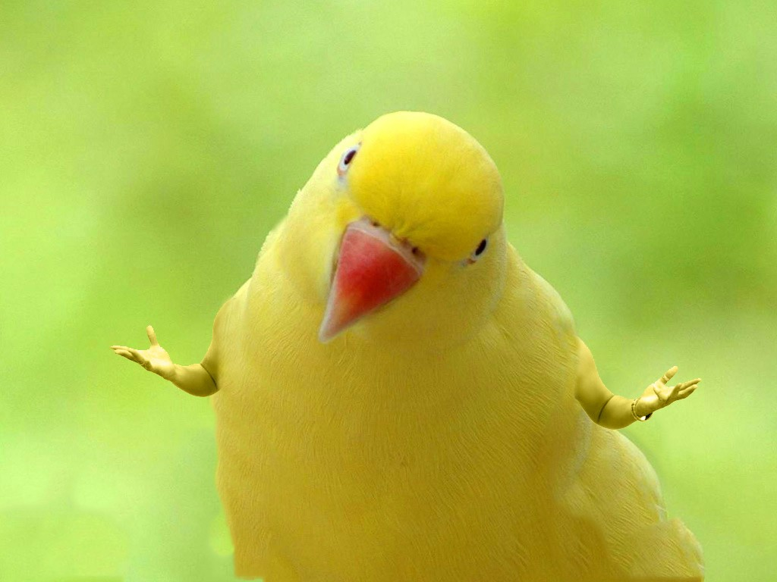

Slide 47
Signatures / CTFs
Put your name in binaries for fun, or hide strings for CTFs
Original Binary
push eax
call 0x401200
Rewritten Binary
push eax
jmp the_call
.ascii “Wartortell was here”
the_call:
call 0x401200

Slide 48
Conclusions
The first binary rewriter for x86 that requires no metadata
Works for Linux and Windows
Two proof of concepts
Low overhead

Slide 49
The FLARE On Challenge
Reversing CTF available online July 7th
Series of reversing challenges I wrote
Tests a variety of reversing skills
X86, x64, ELF, PE, Mach-O, php, js, .NET, C++, etc. could all be included in the challenges
Visit www.flare-on.com for more info

Slide 50
Questions?

Slide 51
Linux Runtime Overhead

Slide 52
Preserving Good Inter-module Flows
IAT data section locked non-writable
Original Code
Rewritten Code
jmp [IAT:CreateWindow]
jmp [IAT:CreateWindow]
CreateWindow
CreateWindow

Slide 53
Computed Inter-module Flows
trusted
library
intermediary
library
(trusted)
rewritten
code
caller
callback stub
callback
callback_ret
return trampoline
computed jumps to trusted modules
dynamic linking (DLLs)
callbacks (event-driven programming)

