Slide 1

Going gets tough
A tale of encounters with novel evasive malware
Marta Janus
Malware Researcher

Slide 2
# whoami
reverse engineering adept & enthusiast
malware researcher @ KL since 2009
linux user since 2006
baldur’s gate player since 1999

Slide 3


Are rootkits on decline?

Slide 4
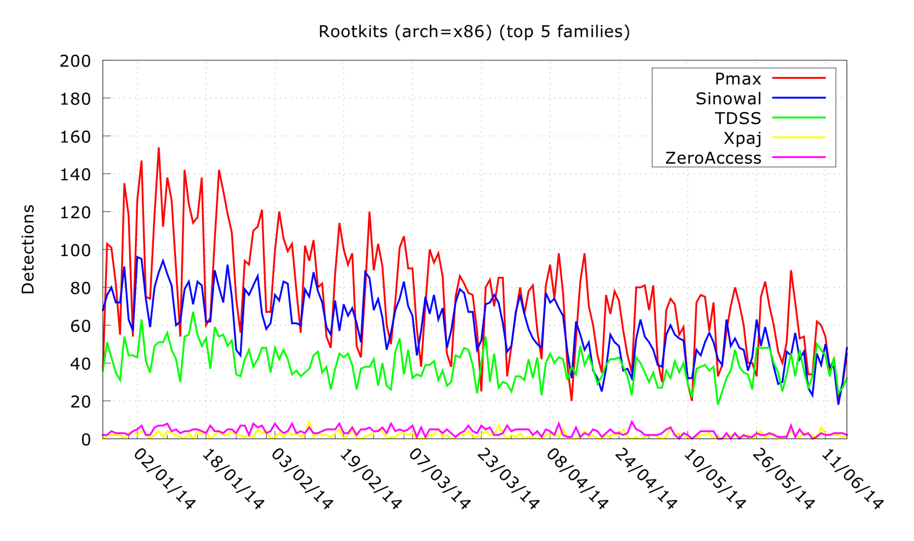

Slide 5
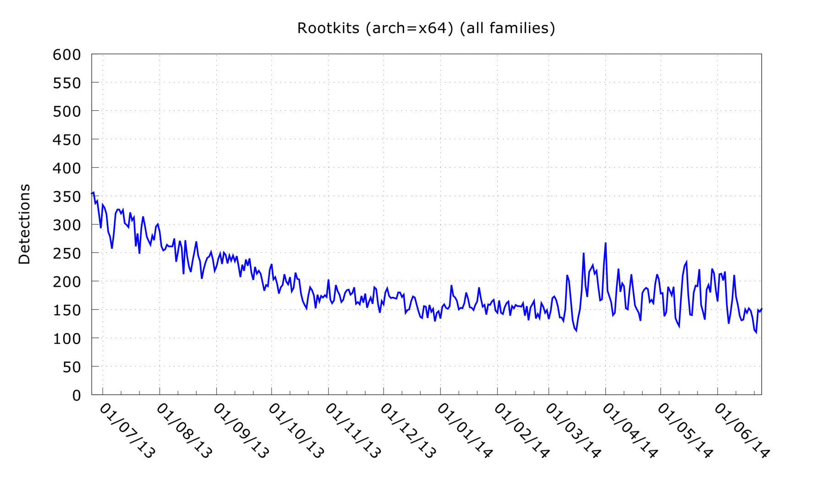

Slide 6
Tough times for rootkits
kernel-space no longer safe for malware
bootkits easily detected
hypervisor-level stealth too complex
shift in malware strategy

Slide 7
Hiding vs. evasion
the goals
hide from admin?
bypass detection
protect C&C infrastructure
protect the payload

Slide 8

Case 1: Baldur
"When the going gets tough, someone hold my rodent!"

Slide 9
# Trojan.Win32.Baldur
set of classical anti-vm / anti-dbg checks
heavily based on a0rtega`s pafish
overly exciting? not really, but...
...a textbook case :)

Slide 10
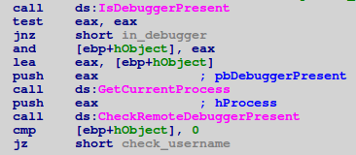
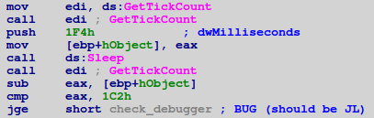
# classic_checks

Slide 11
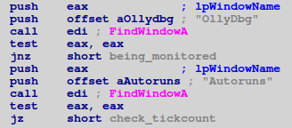
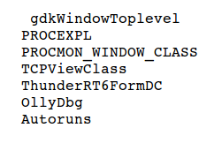
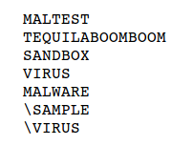

# environmental_checks
WinSpy?
MBAM ?
???

Slide 12
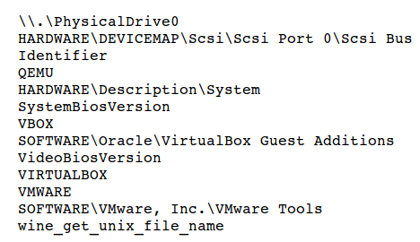
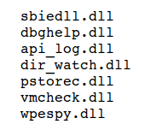
# environmental_checks

Slide 13
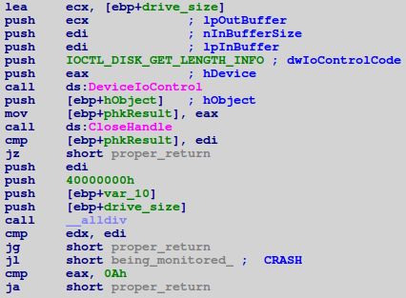
# drive_size_check

Slide 14
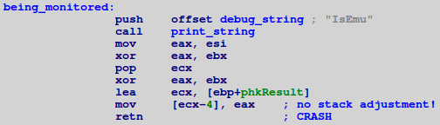
# game_over

Slide 15
Case 2: CVE-0158 & Gimemo
"Evil 'round every corner. Careful not to step in any."

Slide 16
# armed-to-the-teeth
http://www.securelist.com/en/analysis/204792298/The_curious_case_of_a_CVE_2012_0158_exploit
multilayered OLE objects, lots of obfuscation
multi-stage shellcode:
    stage_1: ROP chain
    stage_2: decryptor of stage_3
    stage_3: egg-hunter
    stage_4: dropper

Slide 17
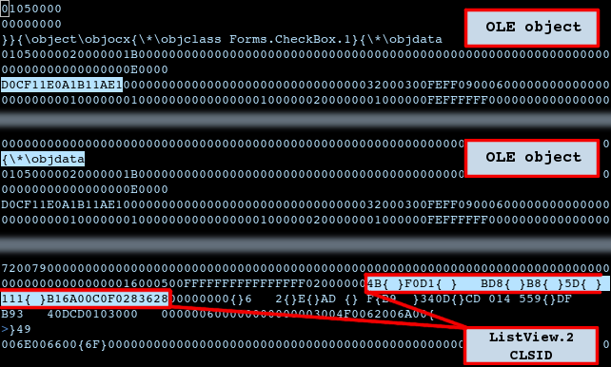

Slide 18
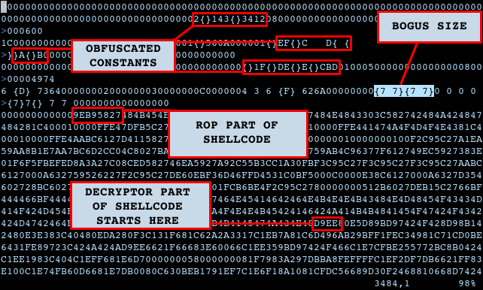

Slide 19
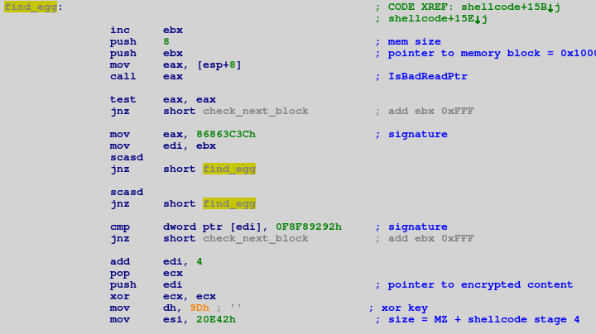

Slide 20
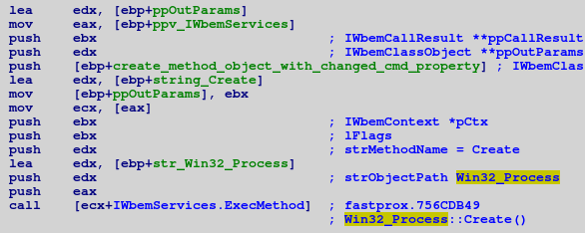
# execute_payload
Notes:
Use of WMI to execute payload (to prevent spawning a child process)

Slide 21
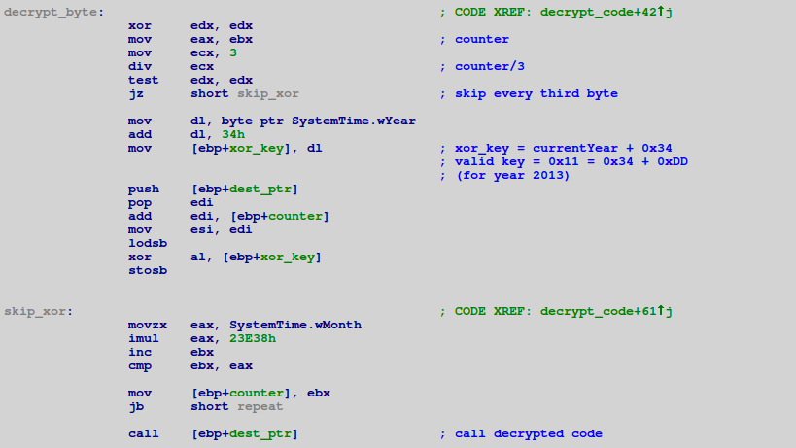
# payload: decrypt_loader

Slide 22
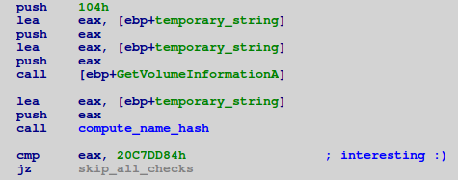

# skip_all_checks

Slide 23
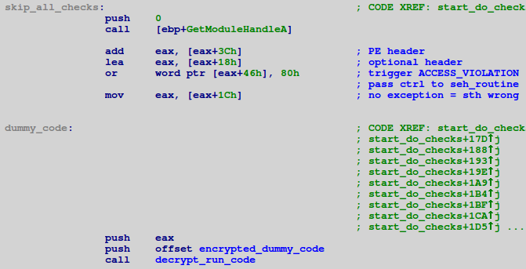
# trigger_exception

Slide 24
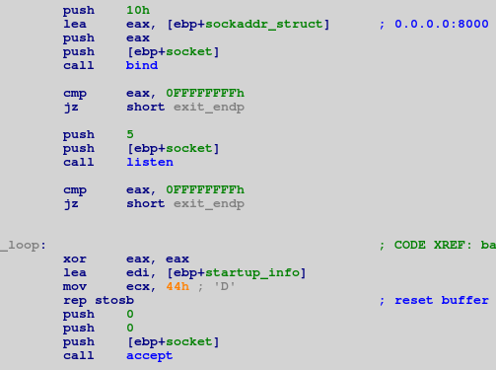
# dummy_code

Slide 25
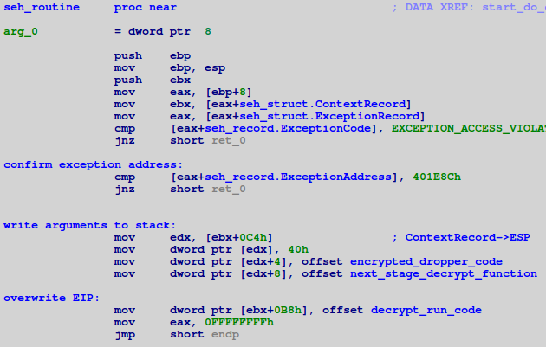
# seh_routine

Slide 26
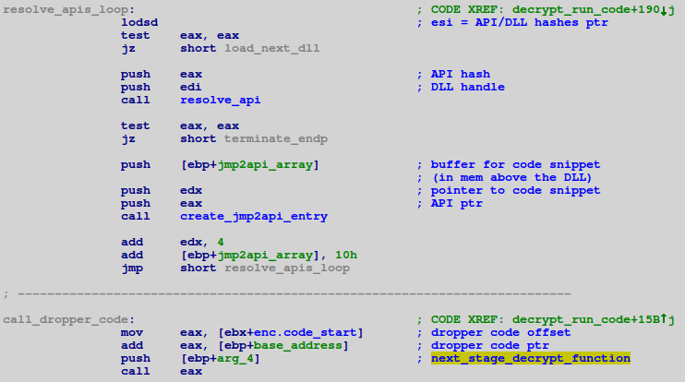
# anti_hook, anti_bp

Slide 27
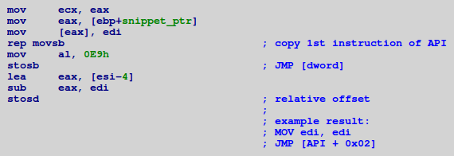
# anti_hook, anti_bp

Slide 28
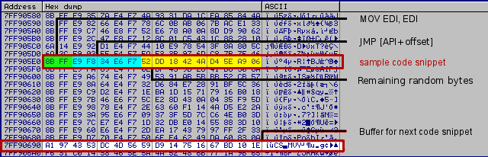
# anti_hook, anti_bp: trampoline

Slide 29
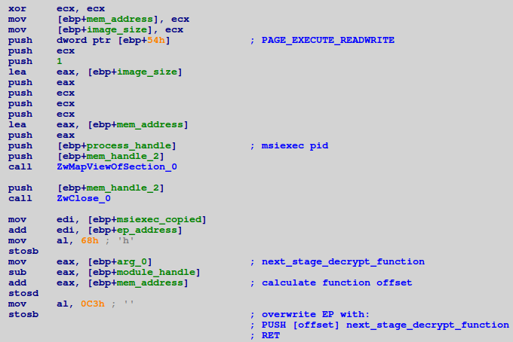
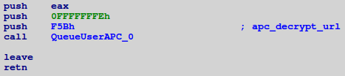
# the dropper & the bot

Slide 30
Case 3: PSW & more SEH
"No effect?! I need a bigger sword!"

Slide 31
# Trojan-PSW.Win32.Multi
also spread via hardened CVE-0158 exploit
also lots of anti-* techniques
code flow of the loader fully based on exception handling blocks
payload saved as a registry value
overwrites fxsst.dll to assure persistance

Slide 32
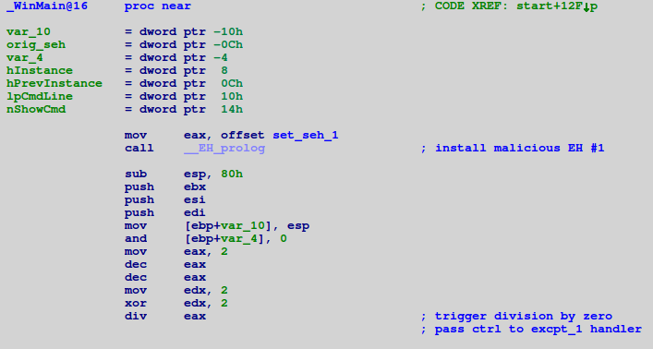
# malware_main; seh chain

Slide 33
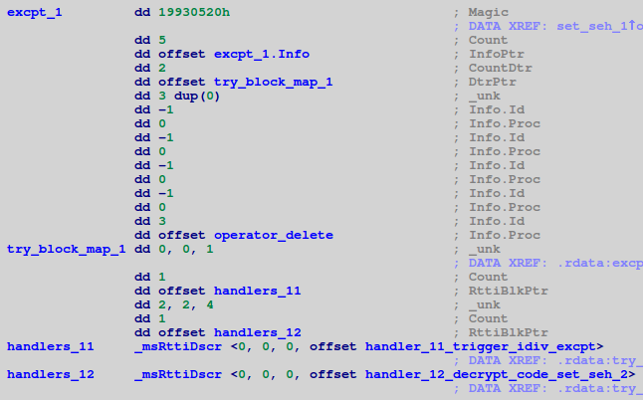
# exception_1

Slide 34
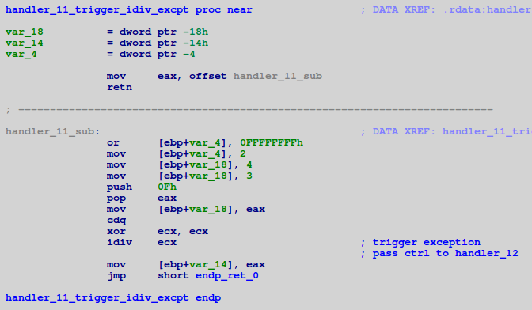
# exception_handler

Slide 35
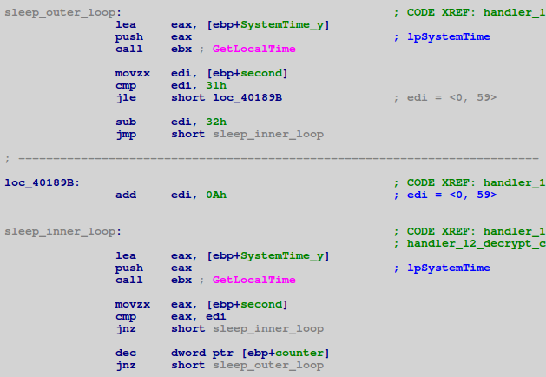
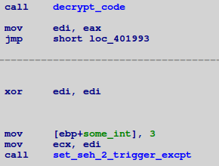
# dormant_phase

Slide 36
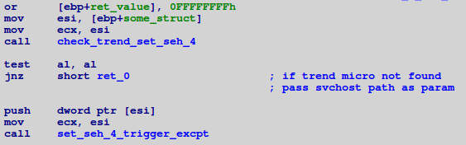

# check_trend_micro

Slide 37
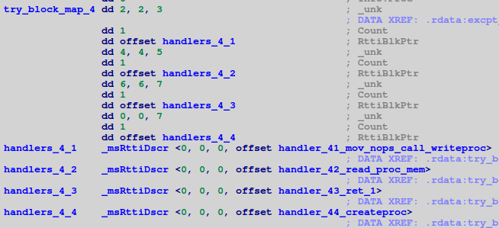
# exception_4

Slide 38
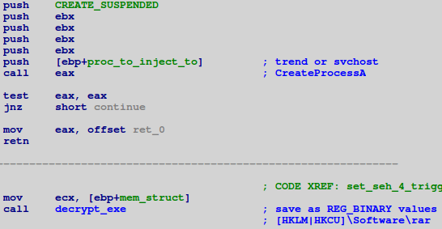
# decrypt_inject

Slide 39
Case 4: hardened Zeus
"Fool me once, shame on you; fool me twice, watch it! I'm huge!"

Slide 40
# Trojan.Win32.Zbot
samples from period of March – May 2014
use of windows messaging system
use of SEH
multiple downloaders
  each with the same set of anti-* techniques

Slide 41
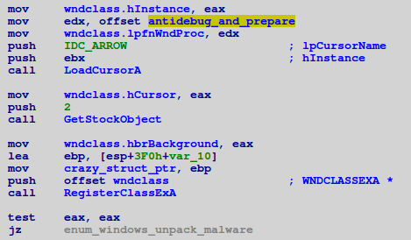
# load_cursor

Slide 42
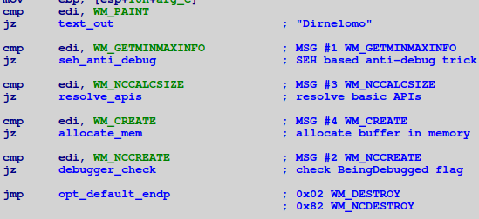
# process_wndmsg

Slide 43
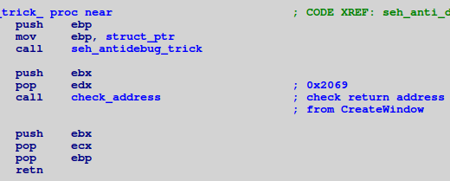
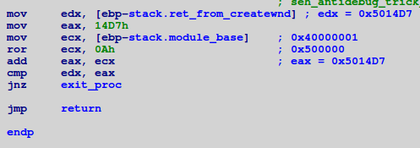
# seh_anti_debug

Slide 44
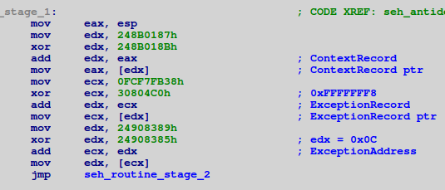
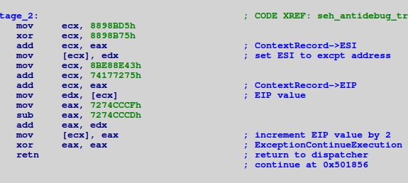
# seh_anti_debug

Slide 45
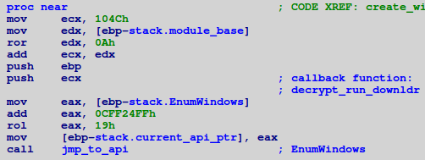

# enum_windows

Slide 46
Case 5: even more hardened Zeus
"Boo says "WHAT?"

Slide 47
# ZeuS p2p aka Game Over
works only on Windows 7
anti-emulation based on default values in the CPU registers
drops Necurs rootkit (!)
bypasses driver signing via setting TESTSIGNING option in BCEDIT

Slide 48
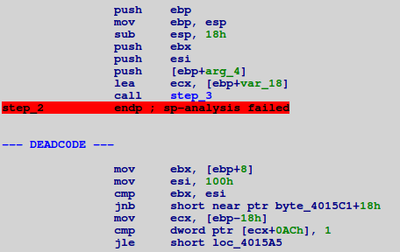
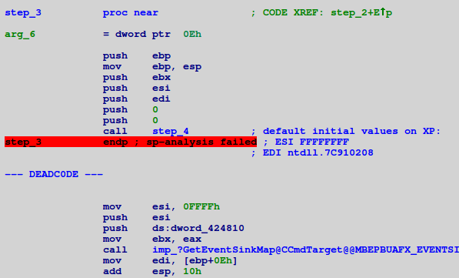
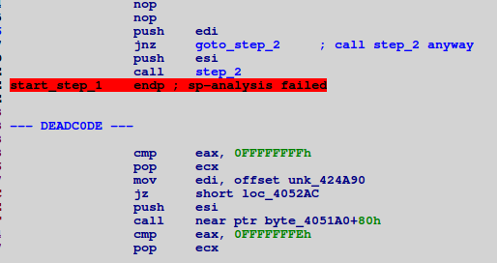

Slide 49
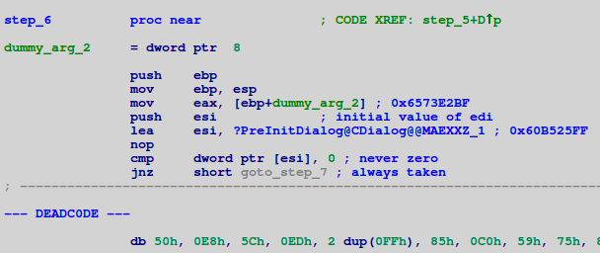
# init_dialog

Slide 50
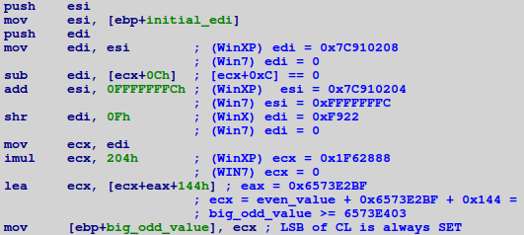
# obfuscated_win7_check

Slide 51
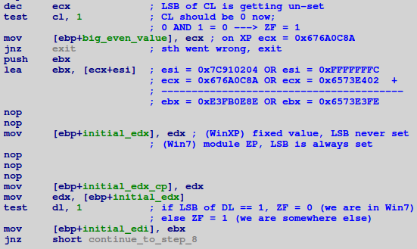
# obfuscated_win7_check

Slide 52
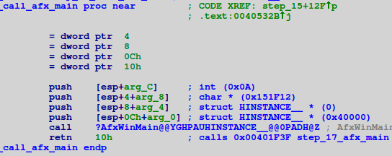
# call_malware_main; step_17

Slide 53
Novel malware architecture
the goals
the aid
bypass detection
anti-emu, anti-heur
protect C&C infrastructure
multiple downloaders,
waterholed websites
protect the payload
anti-re, anti-dbg,
anti-vm, encryption,
obfuscation, etc...

Slide 54
loader
packed, layered encryption, lots of anti-*
injects and executes the dropper code
dropper
some encryption, some anti-*
decrypts and executes the downloader/bot code
bot
small & simple, shellcode-like
used only to get/decrypt/run the payload(s)
payload
downloaded from water-holed websites / pushed by C2
not stored on the disk, short-lived, controlled by C2

Slide 55
Known evasion techniques
time or condition based triggers:
  specified timeframes
  specified settings
  specified system events (e.g. reboot, mouse click, etc.)
environmental checks:
  files on disk, running processes, loaded DLLs, opened windows, mutexes, devices, registry settings.......
checking initial values in CPU registers at EP
  fingerprinting the OS

Slide 56
Known evasion techniques
overrunning sandbox/emulator:
  dromant phase (e.g. sleep loops)
  junk instructions, slower inside VMs (MMX, FPU, etc.)
  benign code (legitimate looking syscalls)
  stalling code (without the use of syscalls)
using window messaging, apc procedures, etc.
using chained Exception Handling mechanisms

Slide 57
Countermeasures
stealth analysis leave no artifacts
full emulation trace all instructions
full exploration follow multiple execution paths
bypass stalling loops detect & skip passive code

Slide 58

Thank You!
marta.janus [at] kaspersky.com
@mvjanus
"We are all heroes: You and Boo and I"

